Slide 1
REQUIREMENTS ENGINEERING
Functional and non functional

Slide 2
Outline
Functional and non-functional requirements
The software requirements specification document (SRS)
Requirements specification
Requirements engineering processes
Requirements elicitation and analysis
Requirements validation
Requirements management

Slide 3
Requirements engineering
The process of establishing the services that the customer requires from a system and the constraints under which it operates and is developed.
The requirements themselves are the descriptions of the system services and constraints that are generated during the requirements engineering process.

Slide 4
What is a requirement?
It may range from a high-level abstract statement of a service or of a system constraint to a detailed mathematical functional specification.
This is inevitable as requirements may serve a dual function:
  May be the basis for a bid for a contract - therefore must be open to interpretation;
  May be the basis for the contract itself - therefore must be defined in detail;

Slide 5
Types of requirement
User requirements
  Statements in natural language plus diagrams of the services the system provides and its operational constraints. Written for customers.
System requirements
  A structured document setting out detailed descriptions of the system’s functions, services and operational constraints. Defines what should be implemented so may be part of a contract between client and contractor.

Slide 6
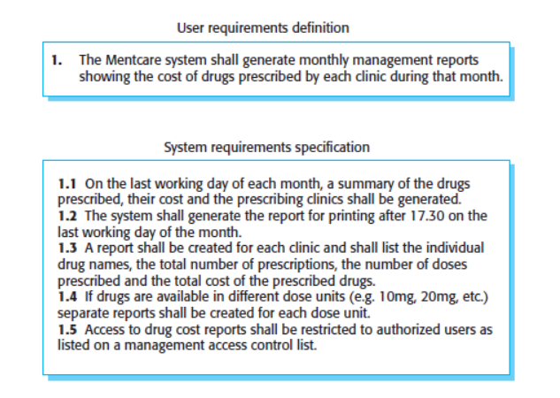
User and system requirements

Slide 7
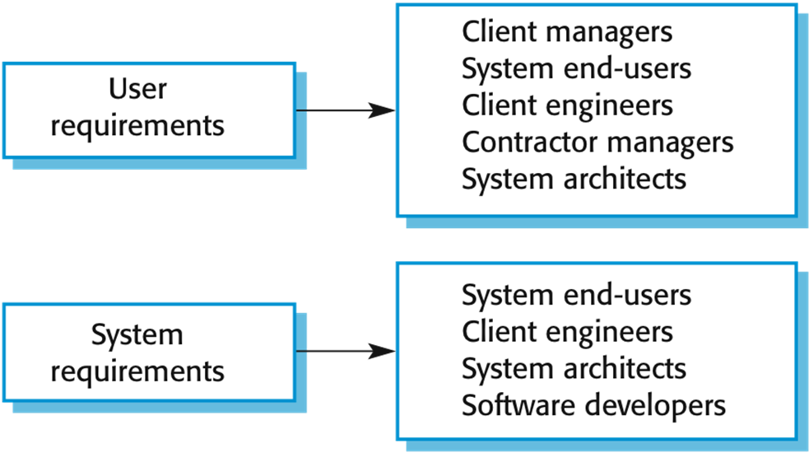
Readers of different types of requirements specification

Slide 8
Functional and non-functional requirements
Functional requirements
  Statements of services the system should provide, how the system should react to particular inputs and how the system should behave in particular situations.
  May state what the system should not do.
Non-functional requirements
  Constraints on the services or functions offered by the system such as timing constraints, constraints on the development process, standards, etc.
  Often apply to the system as a whole rather than individual features or services.

Slide 9
Functional requirements
Describe functionality or system services.
Depend on the type of software, expected users and the type of system where the software is used.
Functional user requirements may be high-level statements of what the system should do.
Functional system requirements should describe the system services in detail.

Slide 10
Functional requirements for the MHC-PMS
A user shall be able to search the appointments lists for all clinics.
The system shall generate each day, for each clinic, a list of patients who are expected to attend appointments that day.
Each staff member using the system shall be uniquely identified by his or her 8-digit employee number.

Slide 11
Requirements imprecision
Problems arise when requirements are not precisely stated.
Ambiguous requirements may be interpreted in different ways by developers and users.
Consider the term ‘search’ in requirement 1
  User intention – search for a patient name across all appointments in all clinics;
  Developer interpretation – search for a patient name in an individual clinic. User chooses clinic then search.

Slide 12
Completeness and consistency
In principle, requirements should be both complete and consistent
Complete
  They should include descriptions of all facilities required
Consistent
  There should be no conflicts or contradictions in the descriptions of the system facilities
In practice, it is impossible to produce a complete and consistent requirements document

Slide 13
Non-functional requirements
These define system properties and constraints e.g. reliability, response time, and storage requirements. Constraints are I/O device capability, system representations, etc.
Process requirements may also be specified mandating a particular IDE, programming language or development method.
Non-functional requirements may be more critical than functional requirements. If these are not met, the system may be useless.

Slide 14
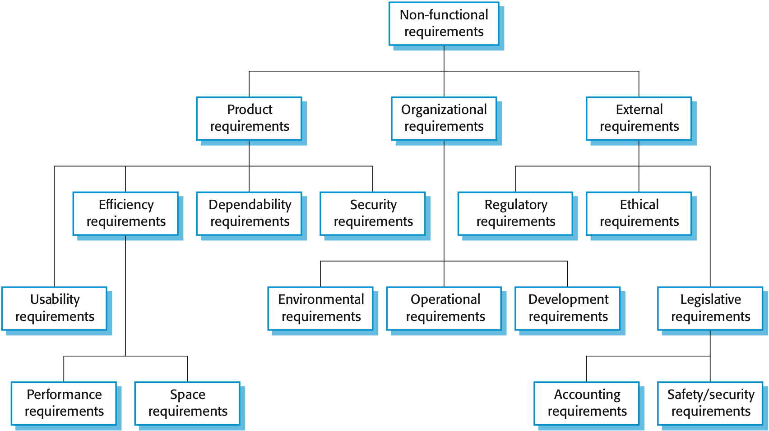
Types of nonfunctional requirement

Slide 15
Implementation
Non-functional requirements may affect the overall architecture of a system rather than the individual components.
  For example, to ensure that performance requirements are met, you may have to organize the system to minimize communications between components.
A single non-functional requirement, such as a security requirement, may generate a number of related functional requirements that define system services that are required.
  It may also generate requirements that restrict existing requirements.

Slide 16
Non-functional classifications
Product requirements
  Requirements which specify that the delivered product must behave in a particular way e.g. execution speed, reliability, etc.
Organizational requirements
  Requirements which are a consequence of organizational policies and procedures e.g. process standards used, implementation requirements, etc.
External requirements
  Requirements which arise from factors which are external to the system and its development process, e.g. interoperability requirements, legislative requirements, etc.

Slide 17
Examples:
Product requirement
The MHC-PMS shall be available to all clinics during normal working hours (Mon–Fri, 0830–17.30). Downtime within normal working hours shall not exceed five seconds in any one day.
Organizational requirement
Users of the MHC-PMS system shall authenticate themselves using their health authority identity card.
External requirement
The system shall implement patient privacy provisions as set out in HStan-03-2006-priv.

Slide 18
Goals and requirements
Non-functional requirements may be very difficult to state precisely and imprecise requirements may be difficult to verify.
Goal
  A general intention of the user such as ease of use.
Verifiable non-functional requirement
  A statement using some measure that can be objectively tested.
Goals are helpful to developers as they convey the intentions of the system users.

Slide 19
Usability requirements
The system should be easy to use by medical staff and should be organized in such a way that user errors are minimized. (Goal)
Medical staff shall be able to use all the system functions after four hours of training. After this training, the average number of errors made by experienced users shall not exceed two per hour of system use. (Testable non-functional requirement)

Slide 20
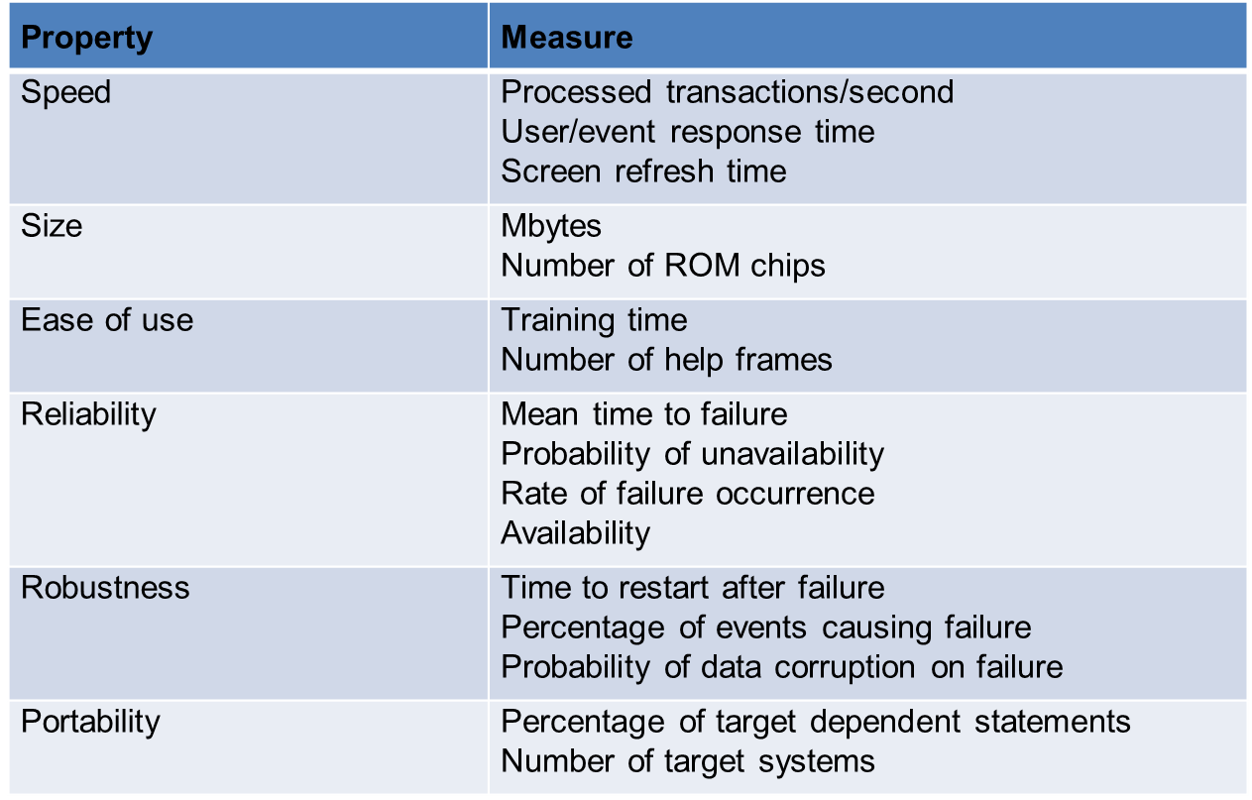
Metrics for non-functional requirements

Slide 21
Domain requirements
The system’s operational domain imposes requirements on the system.
  For example, a train control system has to take into account the braking characteristics in different weather conditions.
Domain requirements can be new functional requirements, constraints on existing requirements, or define specific computations.
If domain requirements are not satisfied, the system may be unworkable

Slide 22
Train protection system
This is a domain requirement for a train protection system:
The deceleration of the train shall be computed as:
  Dtrain = Dcontrol + Dgradient
  where Dgradient is 9.81ms2 * compensated gradient/alpha and where the values of 9.81ms2 /alpha are known for different types of train.
It is difficult for a non-specialist to understand the implications of this and how it interacts with other requirements.

Slide 23
Domain requirements problems
Understandability
  Requirements are expressed in the language of the application domain;
  This is often not understood by software engineers developing the system.
Implicitness
  Domain specialists understand the area so well that they do not think of making the domain requirements explicit.

Slide 24
Agile methods and requirements
Many agile methods argue that producing a requirements document is a waste of time as requirements change so quickly
The document is therefore always out of date
Methods such as XP use incremental requirements engineering and express requirements as ‘user stories’.
This is practical for business systems but problematic for systems that require a lot of pre-delivery analysis (e.g. critical systems) or systems developed by several teams

Slide 25
The software requirements document
The software requirements document is the official statement of what is required of the system developers.
Can include both a definition of user requirements and a specification of the system requirements.
It is NOT a design document. As far as possible, it should set of WHAT the system should do rather than HOW it should do it.

Slide 26
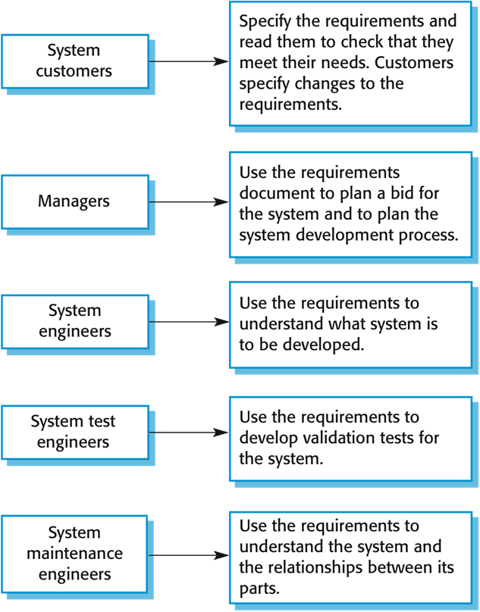
Users of a requirements document

Slide 27
Requirements specification
The process of writing down the user and system requirements in a requirements document
User requirements have to be understandable by end-users and customers who do not have a technical background
System requirements are more detailed requirements and may include more technical information
The requirements may be part of a contract for the system development
  It is therefore important that these are as complete as possible

Slide 28
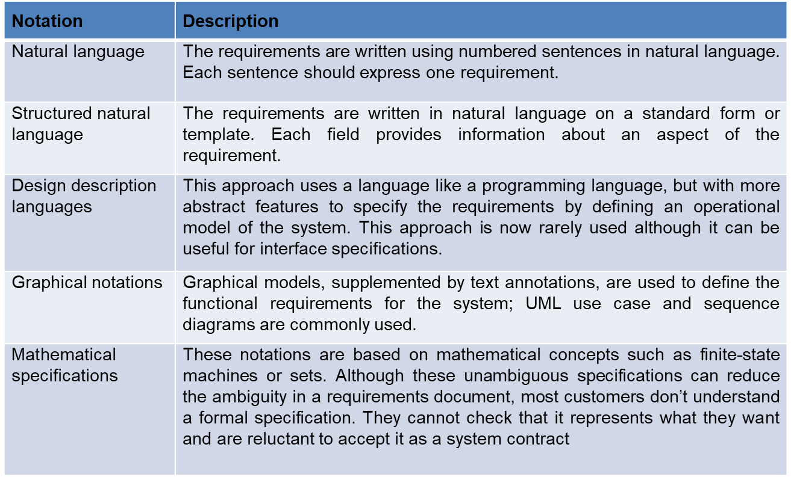
Ways of writing a system requirements specification

Slide 29
Requirements and design
In principle, requirements should state what the system should do and the design should describe how it does this.
In practice, requirements and design are inseparable
  A system architecture may be designed to structure the requirements;
  The system may inter-operate with other systems that generate design requirements;
  The use of a specific architecture to satisfy non-functional requirements may be a domain requirement.
  This may be the consequence of a regulatory requirement.

Slide 30
Natural language specification
Requirements are written as natural language sentences supplemented by diagrams and tables.
Used for writing requirements because it is expressive, intuitive and universal. This means that the requirements can be understood by users and customers.

Slide 31
Guidelines for writing requirements
Create a standard format and use it for all requirements.
Use language in a consistent way. Use shall for mandatory requirements, should for desirable requirements.
Use text highlighting to identify key parts of the requirement.
Avoid the use of computer jargon.
Include an explanation (rationale) of why a requirement is necessary.

Slide 32
Example requirements for the insulin pump software system
3.2 The system shall measure the blood sugar and deliver insulin, if required, every 10 minutes. (Changes in blood sugar are relatively slow so more frequent measurement is unnecessary; less frequent measurement could lead to unnecessarily high sugar levels.)
3.6 The system shall run a self-test routine every minute with the conditions to be tested and the associated actions defined in Table 1. (A self-test routine can discover hardware and software problems and alert the user to the fact the normal operation may be impossible.)

Slide 33
Requirements engineering processes
The processes used for RE vary widely depending on the application domain, the people involved and the organisation developing the requirements.
However, there are a number of generic activities common to all processes
  Requirements elicitation;
  Requirements analysis;
  Requirements validation;
  Requirements management.
In practice, RE is an iterative activity in which these processes are interleaved.

Slide 34
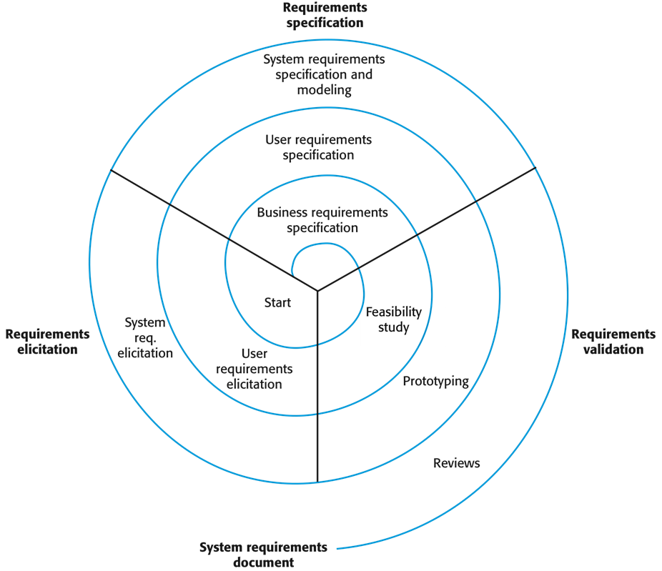

Slide 35
Requirements elicitation and analysis
Sometimes called requirements elicitation or requirements discovery.
Involves technical staff working with customers to find out about the application domain, the services that the system should provide and the system’s operational constraints.
May involve end-users, managers, engineers involved in maintenance, domain experts, trade unions, etc. These are called stakeholders.

Slide 36
Problems with the requirements gathering
Stakeholders don’t know what they really want.
Stakeholders express requirements in their own terms.
Different stakeholders may have conflicting requirements.
Organisational and political factors may influence the system requirements.
The requirements change during the analysis process. New stakeholders may emerge and the business environment may change.

Slide 37
The requirements elicitation
Software engineers work with a range of system stakeholders to find out about the application domain, the services that the system should provide, the required system performance, hardware constraints, other systems, etc

Slide 38
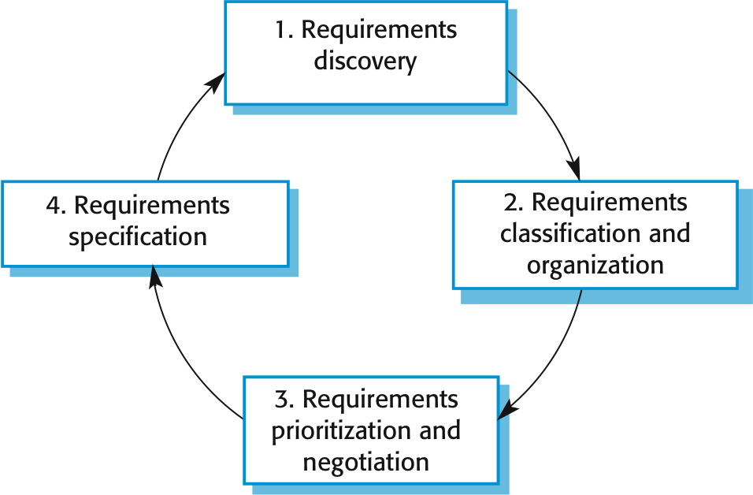
The requirements elicitation

Slide 39
Methods for requirements gathering/discovery
Interview
Use case
Observations
Literature study

Slide 40
Interview
Formal or informal interviews with stakeholders are part of most RE processes.
Types of interview
  Closed interviews based on pre-determined list of questions
  Open interviews where various issues are explored with stakeholders.
Effective interviewing
  Be open-minded, avoid pre-conceived ideas about the requirements and are willing to listen to stakeholders.
  Prompt the interviewee to get discussions going using a springboard question, a requirements proposal, or by working together on a prototype system.

Slide 41
Interviews in practice
Normally a mix of closed and open-ended interviewing.
Interviews are good for getting an overall understanding of what stakeholders do and how they might interact with the system.
Interviews are not good for understanding domain requirements
  Requirements engineers cannot understand specific domain terminology;
  Some domain knowledge is so familiar that people find it hard to articulate or think that it isn’t worth articulating.

Slide 42
Use cases
Use-cases are a scenario based technique in the UML which identify the actors in an interaction and which describe the interaction itself.
A set of use cases should describe all possible interactions with the system.
Sequence diagrams may be used to add detail to use-cases by showing the sequence of event processing in the system.

Slide 43
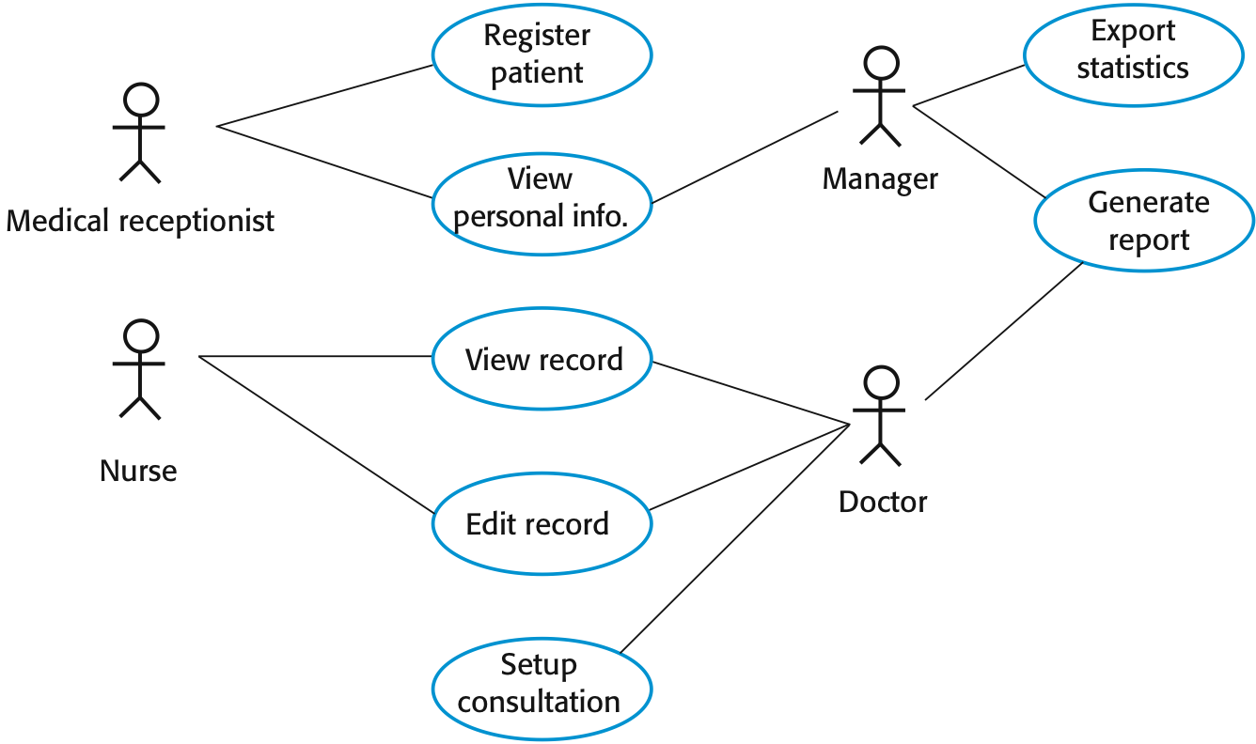
Use cases for the MHC-PMS

Slide 44
Ethnography
A social scientist spends a considerable time observing and analysing how people actually work.
People do not have to explain or articulate their work.
Social and organisational factors of importance may be observed.
Ethnographic studies have shown that work is usually richer and more complex than suggested by simple system models.

Slide 45
Requirements analysis
Requirements classification and organization
  Groups related requirements and organizes them into coherent clusters.
Prioritization and negotiation
  Prioritizing requirements and resolving requirements conflicts.
Requirements specification
  Requirements are documented and input into the next round of the spiral.

Slide 46
Requirements validation
Concerned with demonstrating that the requirements define the system that the customer really wants.
Requirements error costs are high so validation is very important
  Fixing a requirements error after delivery may cost up to 100 times the cost of fixing an implementation error.

Slide 47
How to validate?
Validity. Does the system provide the functions which best support the customer’s needs?
Consistency. Are there any requirements conflicts?
Completeness. Are all functions required by the customer included?
Realism. Can the requirements be implemented given available budget and technology
Verifiability. Can the requirements be checked?

Slide 48
Properties of a good requirement
Verifiability
  Is the requirement realistically testable?
Comprehensibility
  Is the requirement properly understood?
Traceability
  Is the origin of the requirement clearly stated?
Adaptability
  Can the requirement be changed without a large impact on other requirements?

Slide 49
Requirements Management
Requirements management is the process of managing changing requirements during the requirements engineering process and system development.
New requirements emerge as a system is being developed and after it has gone into use.
You need to keep track of individual requirements and maintain links between dependent requirements so that you can assess the impact of requirements changes. You need to establish a formal process for making change proposals and linking these to system requirements.

Slide 50
Changing requirements
The business and technical environment of the system always changes after installation.
  New hardware may be introduced, it may be necessary to interface the system with other systems, business priorities may change (with consequent changes in the system support required), and new legislation and regulations may be introduced that the system must necessarily abide by.
The people who pay for a system and the users of that system are rarely the same people.
  System customers impose requirements because of organizational and budgetary constraints. These may conflict with end-user requirements and, after delivery, new features may have to be added for user support if the system is to meet its goals.
Large systems usually have a diverse user community, with many users having different requirements and priorities that may be conflicting or contradictory.
  The final system requirements are inevitably a compromise between them and, with experience, it is often discovered that the balance of support given to different users has to be changed.

Slide 51
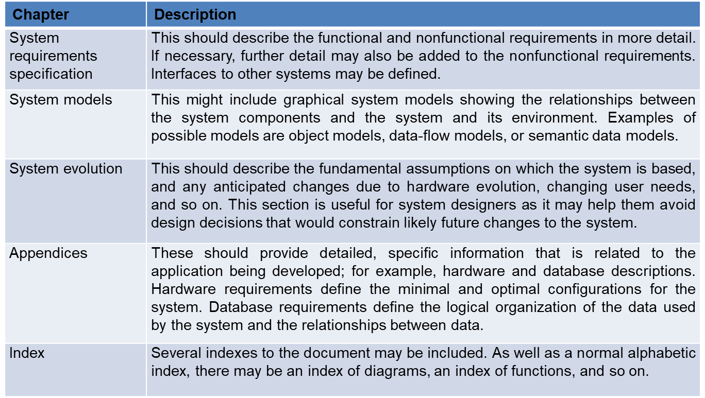
Overview of SRS document

